Slide 1
Human Computer Interaction Project
By: Walker Daniels, Oscar Salinas, Robert Taylor, Zachary Urrutia
COSC-3360-001

Slide 2
Overview
Introduction
Provided Data Instance
Preparing Data
Determining Occurrences
Algorithmic Description & Implementation
Pros & Cons
Further Improvements

Slide 3
Introduction
Implement and Design a project that can Identify the Gross Pay of an individual on Unigram Language Model by Corpus Cross Entropy.
Manipulating data within a CSV File.
Language: Python

Slide 4
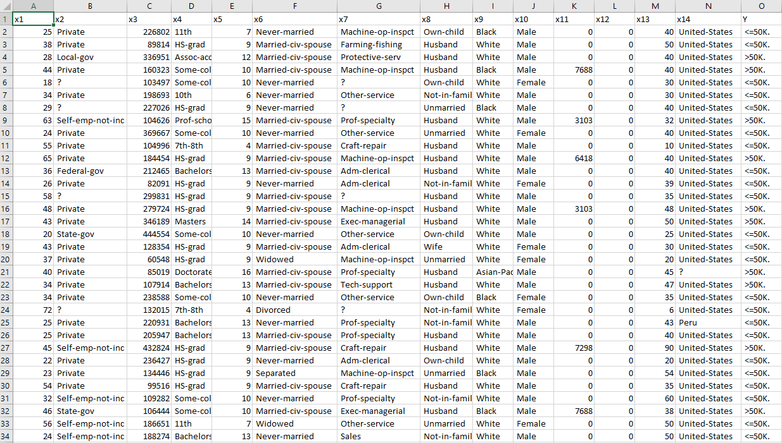
Provided Data Instances
Data Instance provided to use in our project
Human.csv
Education
Level
Race
Sexuality
Gender

Slide 5
Preparing Data

Slide 6
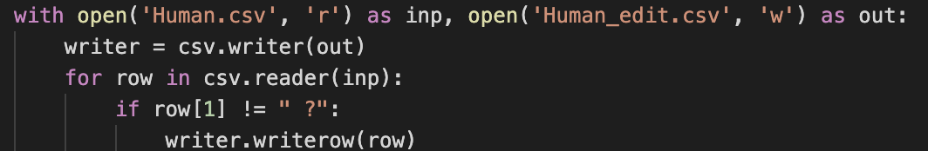
Part 1: Rid of Rows with “?”
The code provided below demonstrates the process of how we got the raid of rows which contains ’?’ in the data set.

Slide 7
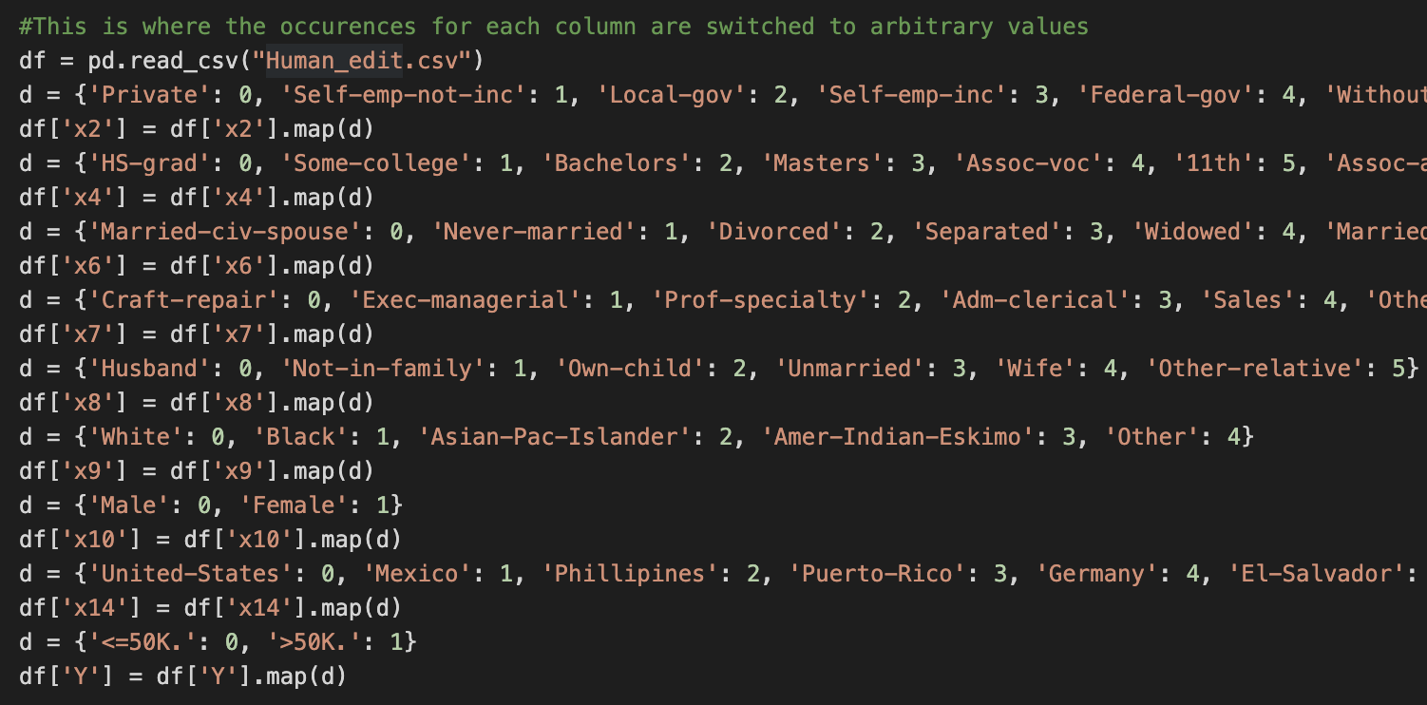
Part 2: Arbitrary Code
Part of the arbitrary code requirement.

Slide 8
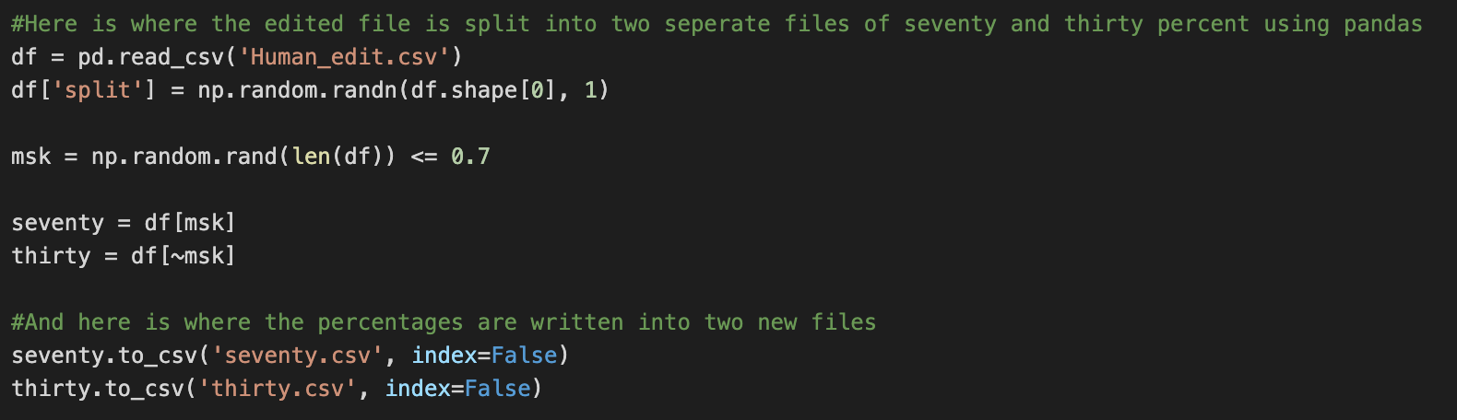
Part 3: Divide Data 70% & 30%
This snippet of code is how we split the data into two files of 70 and 30 percent accordingly.

Slide 9
Determining Occurrences

Slide 10
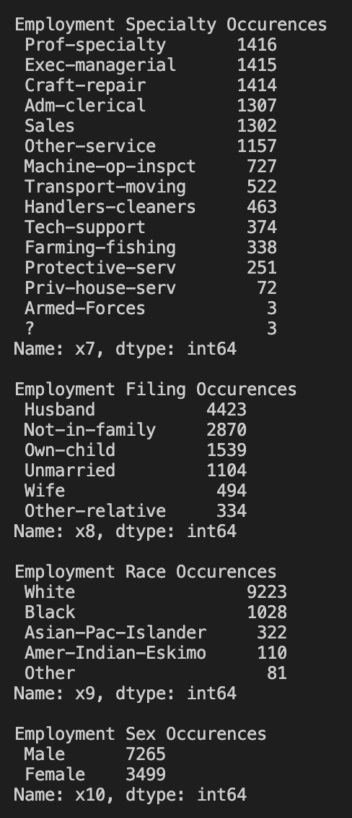
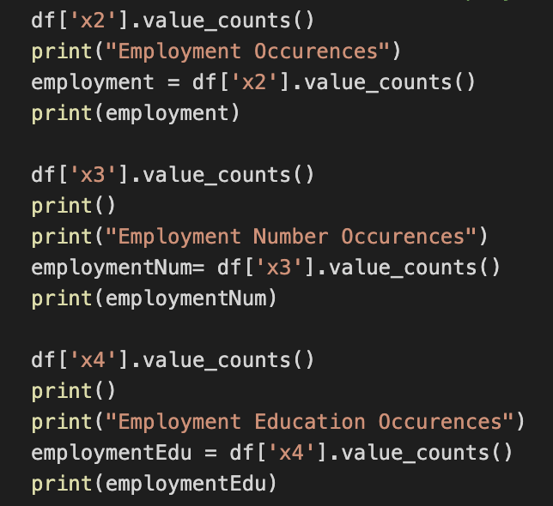
Part 1: Tests on the 70% data
The code snippet and the output of the # of occurrences for each attributes.
Occurrences Output
Number of Occurrences Code

Slide 11
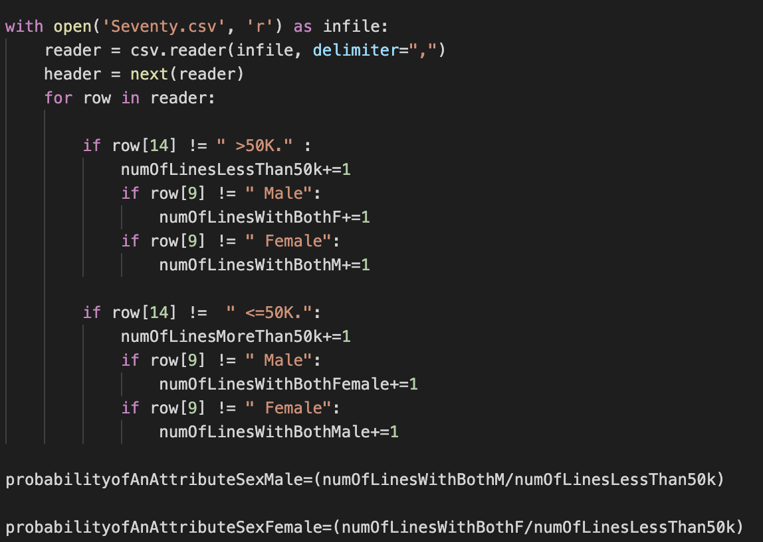
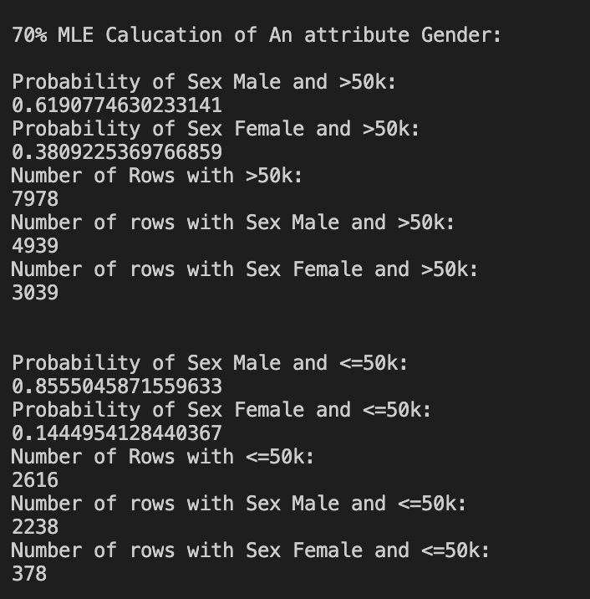
Part 1: Continued
MLE Algorithm - Assigning values to variables
Calculating the probability of Sex and their income using the 70% data set
MLE Output

Slide 12
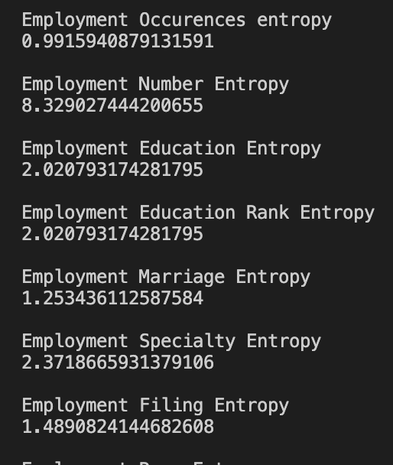
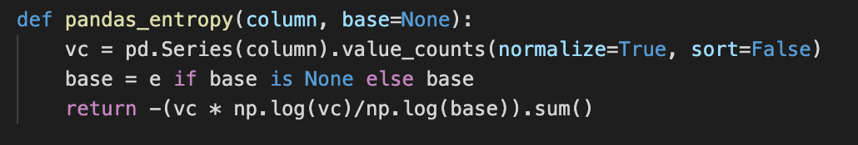
Part 2: Tests on the 70% data
Using the Corpus Cross Entropy method we were able calculate the entropy for each instances..
Entropy Function
Entropy Output

Slide 13
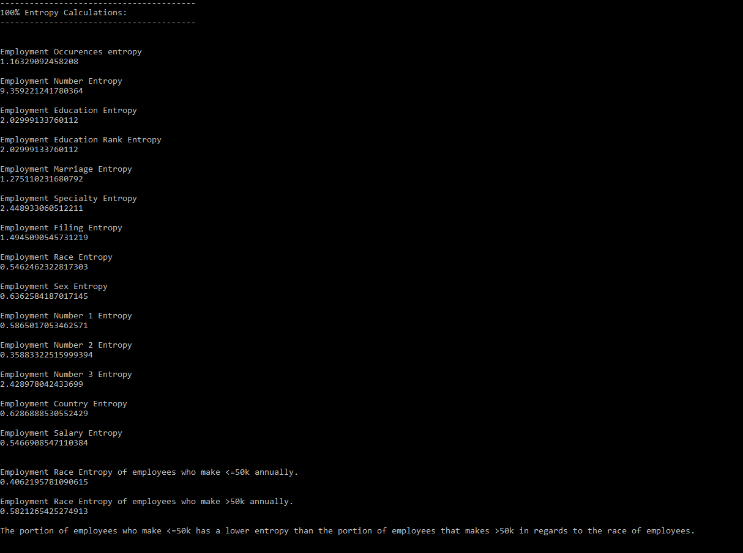
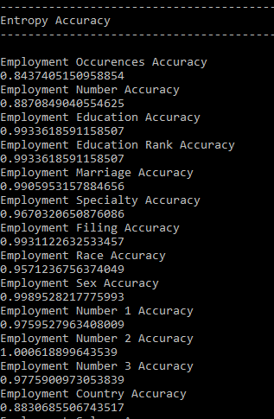
Implementation Results
Entropy Output - 100% dataset
Entropy Accuracy - Calculated using the 30% output
For the most part the 30% dataset had a high accuracy the lowest being 84%

Slide 14
Pros & Cons
Pros of our design choice
The array of information given to the user.
Easy implementation for the user to do.
Cons of our design choice
Display of information given.
Implementing a feature allowing the user to run the algorithms for each file (human, 70%, and 30$). Then calculating the accuracy for each data set.

Slide 15
Further Improvements
Visual Output of Data Information
Make it more visually appealing to the audience.
Interactive UI - So the information isn’t displayed all at once, this ties in with visual output
Require an instruction manual or guide for this program, for the user.

Slide 16


